Slide 1
NLP Project(CS 6120)
LyricLab
Krishna Venkatesh, Laasya Anantha Prasad, Shikha Tiwari
Link to Presentation : https://drive.google.com/file/d/1q0IES2qRtYMugqhekxcLgN8RspQirEj_/view?usp=share_link

Slide 2
Main Goal :
Using natural language processing (NLP) to generate song lyrics, machine learning algorithms are trained on massive song lyrics datasets to identify recurring themes, patterns, and structures in songwriting.
Primary objective: Develop text generation models using Naive Bayes To create new lyrics, Ngram, Transformers, and Recurrent Neural Networks (RNNs) are frequently utilized.
Examine and contrast lyric generating language models.

Slide 3
Tasks in hand :
The task for this project is to generate lyrics similar to Ed Sheeran’s songs.
We trained 3 different models for lyrics generation and compared and contrasted between them - N Gram language Model, RNN and Transformers
Build trigram probability Graph to predict next word in the sentence. Calculate perplexity and score
Build RNN LSTM model for next word generation
Train GPT-2 transformer on same dataset to compare the results

Slide 4
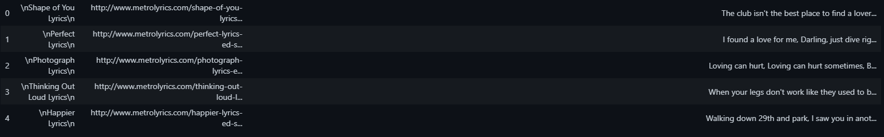
What is the data?
The Ed Sheeran dataset consists of 179 rows and 3 columns.
The dataset contains 111 unique songs.
The total vocabulary size, which refers to the number of unique words used across all songs, is 4,632.
The total number of tokens, which represents the total count of all words used in the lyrics, is 62,012.

Slide 5

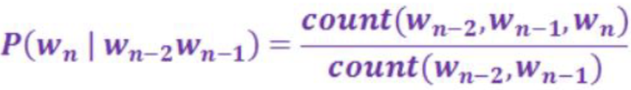

What models were used, how does it work?
NGram Language Model -
An n-gram language model is a statistical model used to predict the probability of a word given the preceding n-1 words in a sequence of text.
P(w|h) is the probability of a word w given some history h. Let sentence be “its water is so transparent that”. The prob is given by -
Probability graph for every trigram was calculated using Bayes rule (for trigram)

Slide 6
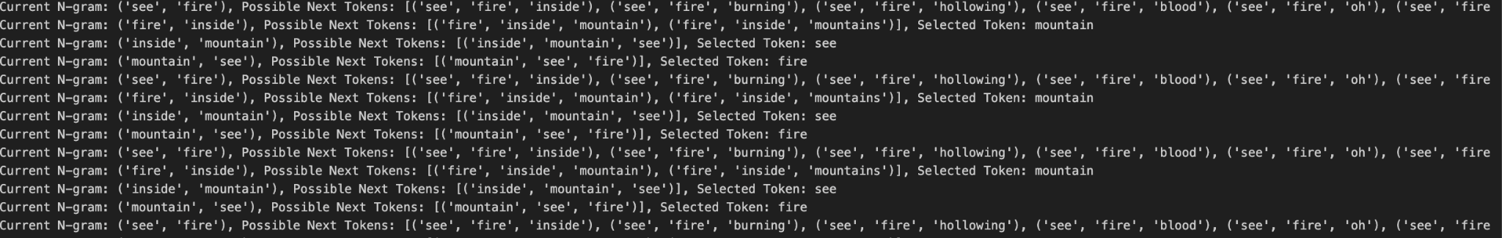
What models were used, how does it work?
Naive Bayes N-Gram Language Model -
Probability graph for every trigram was calculated using Bayes rule

Slide 7
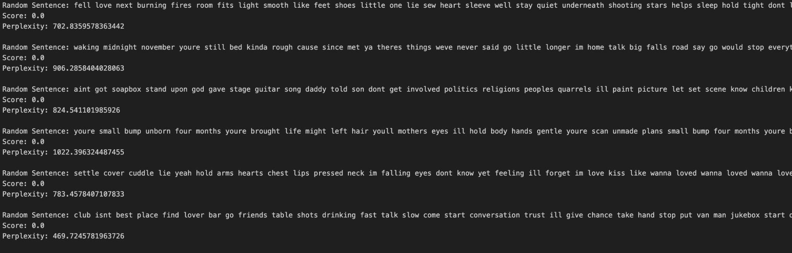
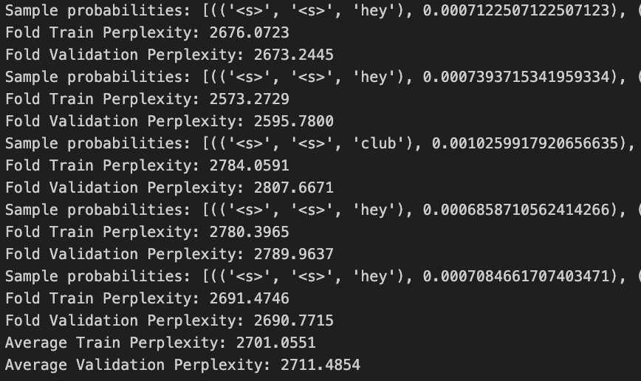
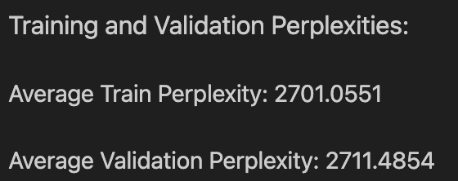
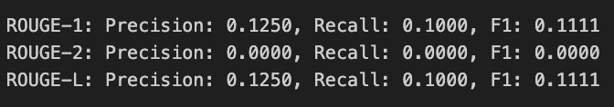

Results - Score and Accuracy
Naive Bayes Trigram Language Model
Average perplexity around 800
High perplexity due to small sized dataset, less variability

Slide 8
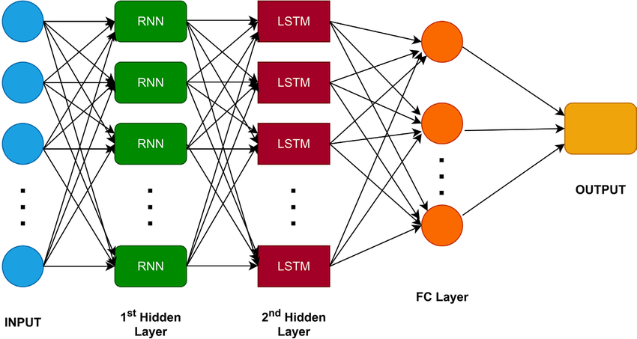
What models were used, how does it work?
RNN - LSTM
RNNs are often used for lyrics generation because they can capture the sequential dependencies between words.
The model takes a sequence of words as input and generates a sequence of words that follows it.

Slide 9
What models were used, how does it work?
RNN - LSTM
The dataset has been divided into smaller segments, with each segment containing 7 words. This means the data has been organized into sequences of 7 words each, which are then inputted into the RNN network.
Train [['ill', 'take', 'ya', 'id', 'rather', 'stay', 'sofa'], ['youre', 'strumming', 'heart', 'strings', 'like', 'grade', 'eight'], ['im', 'love', 'shape', 'one', 'week', 'let', 'story'], ['need', 'man', 'dont', 'need', 'need', 'man', 'dont'], ['live', 'life', 'like', 'youre', 'giving', 'cause', 'act'], ['grass', 'listening', 'favorite', 'song', 'saw', 'dress', 'looking'], ['hold', 'tonight', 'would', 'stop', 'trying', 'fall', 'love'], ['oh', 'give', 'love', 'oh', 'give', 'love', 'give'], ['hallelujah', 'angel', 'shape', 'mum', 'fell', 'youd', 'holding'], ['warm', 'hands', 'gold', 'always', 'cold', 'womans', 'hands']]
Test [['someone', 'else', 'ive', 'got', 'save', 'blame', 'someone'], ['man', 'dont', 'need', 'need', 'man', 'dont', 'need'], ['road', 'say', 'go', 'would', 'stop', 'everything', 'oh'], ['forever', 'could', 'stay', 'tell', 'im', 'wrong', 'tell'], ['last', 'thing', 'see', 'want', 'know', 'enough', 'cause'], ['act', 'like', 'go', 'ahead', 'live', 'go', 'tear'], ['need', 'man', 'dont', 'need', 'need', 'man', 'dont'], ['mmy', 'mmy', 'give', 'love', 'lover', 'mmy', 'mmy'], ['friend', 'left', 'sell', 'clothes', 'one', 'works', 'coast'], ['thats', 'okay', 'baby', 'words', 'bleed', 'inside', 'pages']]

Slide 10
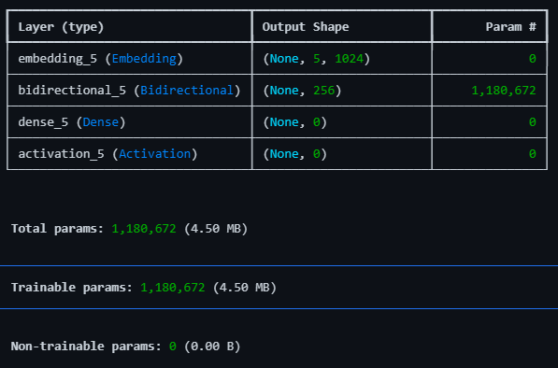
What models were used, how does it work?
RNN - LSTM
Model Architecture - The model begins with an Embedding layer that converts word indices into dense vectors of fixed size. This is followed by a Bidirectional LSTM layer, which processes the sequences in both forward and backward directions to capture dependencies from both ends. Finally, a Dense layer is used to produce the output, representing the probability distribution over the vocabulary for the next word in the sequence.
Activation Function - The output of the Dense layer is passed through a Softmax activation function to produce probabilities. The model is optimized using the Adam optimizer.

Slide 11
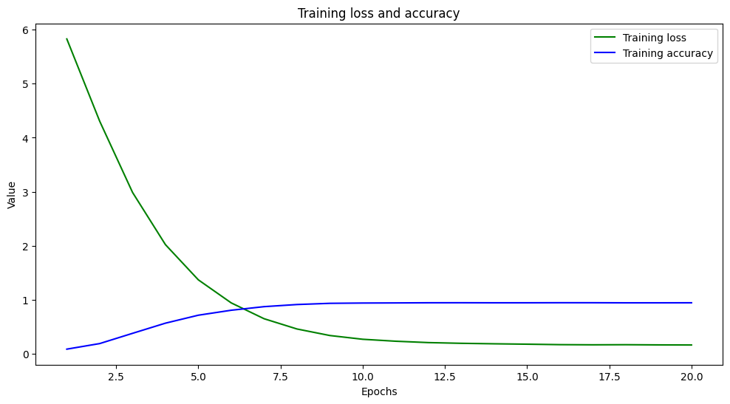
What models were used, how does it work?
RNN - LSTM - Evaluation
-Early Epochs:
- The model improves both in training and validation metrics, indicating good learning.
- Later Epochs:
- Training loss continues to decrease, and training accuracy continues to increase, while validation metrics (loss and accuracy) do not show corresponding improvements.
The model appears to be overfitting the training data:
- The model performs very well on the training data (high training accuracy and low training loss).
- Validation loss fluctuates and does not continue to improve after a certain number of epochs.
- Validation accuracy plateaus and does not show significant improvement, indicating that the model's performance on unseen data does not improve as it continues to train

Slide 12
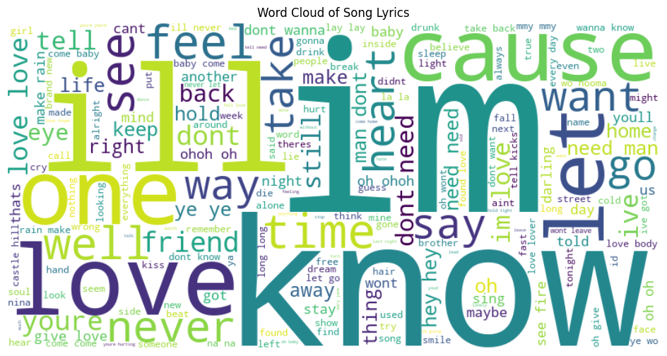
What models were used, how does it work?
RNN - LSTM Evaluation
Word Cloud Analysis
The word cloud shows the frequency of words in the song lyrics, with larger words like "know," "love," "I'm," and "cause" appearing more often. Common themes include emotions and relationships, indicated by words such as "feel," "heart," and "time." This visual representation highlights the focus on personal and emotional content in the lyrics.

Slide 13
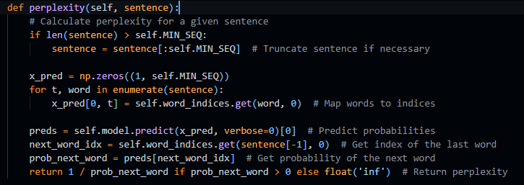
What models were used, how does it work?
RNN LSTM - Text generation (Example) - Evaluation
Lyrics Generated: six years old broke leg running brother friends tasted sweet perfume mountain grass rolled younger take back found heart broke made friends lost years ive seen roaring fields long know ive grown cant wait go home im way driving 90 country lanes singing tiny dancer miss way make feel real watched sunset castle hill fifteen years old smoking handrolled cigarettes running law backfields getting drunk friends first kiss friday night dont reckon right younger take back found weekend jobs got paid wed buy cheap spirits drink straight friends thrown long oh weve grown cant wait go home im way driving 90 country lanes singing tiny dancer miss way make feel real watched sunset castle hill castle hill castle hill one friend left sell clothes one works coast one two kids lives alone ones brother overdosed ones already second wife ones barely getting people raised cant wait go home im way still remember old country lanes know answers miss way make feel real watched sunset castle hill castle hill castle hill
Perplexity: 363.9658749098659

Slide 14

What models were used, how does it work?
RNN LSTM - Rouge Scores- Evaluation
The ROUGE scores indicate the generated text captures key words and sequences from the reference text effectively. With a high ROUGE-1 (0.6252) and ROUGE-L (0.6167), it shows good overlap of individual words and sequence structure, but the moderate ROUGE-2 (0.1957) suggests room for improvement in capturing specific two-word phrases. Overall, the generated text is quite similar to the reference in terms of word choice and structure.

Slide 15
Enhancements for RNN-LSTM
Model Architecture Improvements:
Experiment with more complex architectures such as Transformer-based models (e.g., BERT or GPT) for better performance.
Add additional layers or use different types of RNNs (e.g., GRU) to enhance the model's learning capacity.
Enhanced Training and Evaluation:
Implement hyperparameter tuning (e.g., using grid search or Bayesian optimization) to find the optimal parameters for the model.
Incorporate additional evaluation metrics (e.g., BLEU score for text generation) and perform cross-validation to better assess model performance.

Slide 16
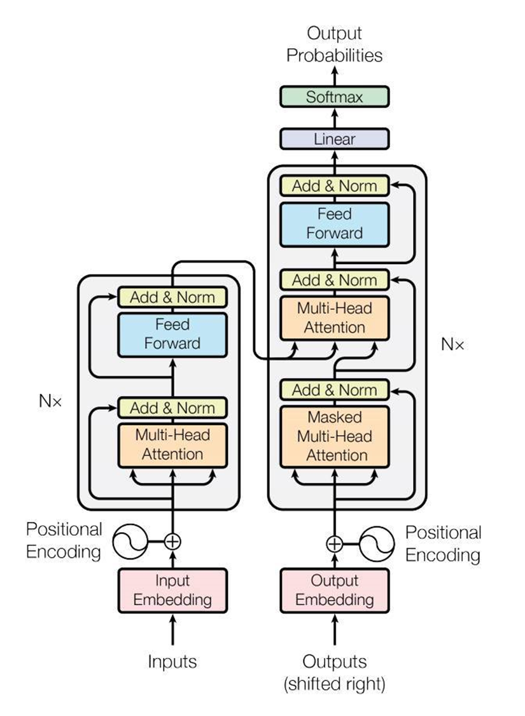
GPT2 Transformer based model
GPT-2 is a Transformer-based model trained for language modelling
Unlike RNNs and LSTMs, transformers process data in parallel and capture relationships between all elements in a sequence simultaneously.
Transformers do not rely on recurrence but instead operate on self-attention.
Self-attention allows the model to weigh the importance of different input tokens when making predictions, enabling it to capture long-range dependencies without the need for sequential processing.
Transformers Architecture-
Encoder
multi-head self attention
Position embedding
Feedforward network
Non-linearity and normalization in-between
Decoder
Multi-head cross attention
And others in the encoder
Transformer Architecture

Slide 17
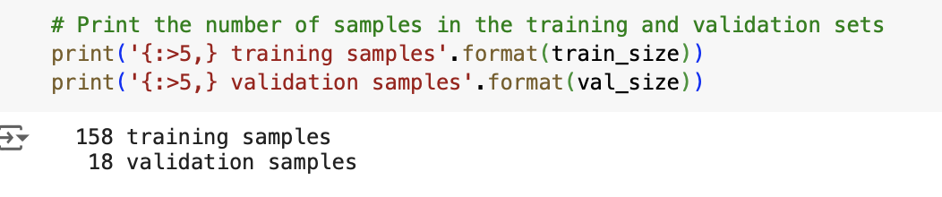
Fine Tuning GPT2 Model
Training and validation datasets-
We can see dataset is fairly small, which might impact the performance and generalization ability of model.
Utilizing pretrained models like GPT-2, can significantly help because they have already been trained on large corpora. Fine-tuning such models on small dataset can yield better results than training from scratch.
GPT-2 Architecture

Slide 18
Flow of GPT2 Model
Prepare Data
Tokenization and dataset preparation
Model Configuration
Model Training
Generate text
Import necessary libraries and loading the data to be used to train - ed_sheeran_lyrics
Perform preprocessing on the lyrics data , clean it , drop any NA values.
Tokenize lyrics
Initialize GPT-2 tokenizer
Define “GPT2Dataset” class for encoding text and preparing input IDs and attention masks.
Split the dataset into training and validation sets and creating data loader with appropriate samplers and batch sizes.
Load GPT-2 Model
Define Hyperparameter- we have performed for multiple configuration of hyperparameter experimenting over multiple epochs and learning rate.
Define optimizer and scheduler.
Training Loop
Set model to training mode, iterate over training batches.
Move data to GPU, compute loss, perform backpropagation, and update weights.
Validation Loop
Set model to evaluation mode, Iterate over validation batches and compute validation loss
Use the trained model to generate text.
Load model and tokenizer.
Generate sample text based on a prompt.

Slide 19
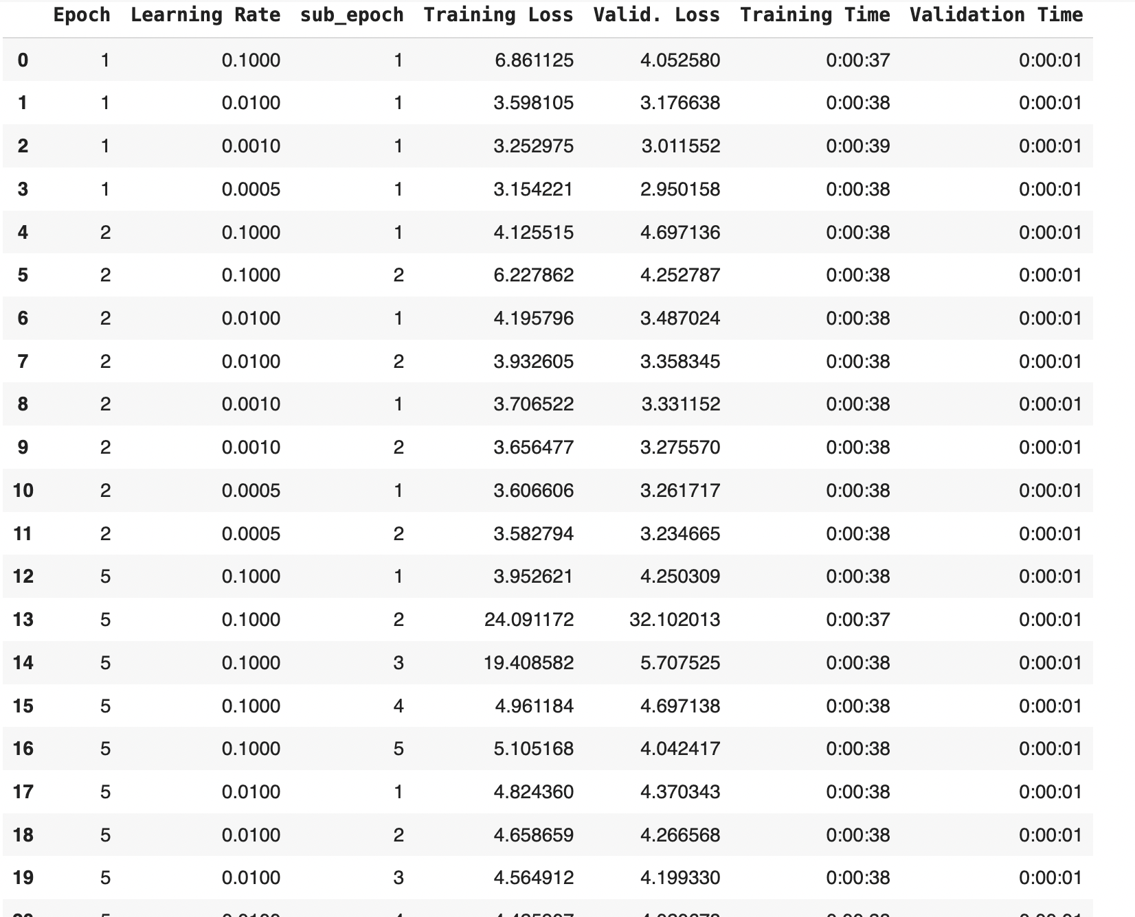
Output of GPT2 Model
Sample text generated from trained GPT2 Model -

Slide 20
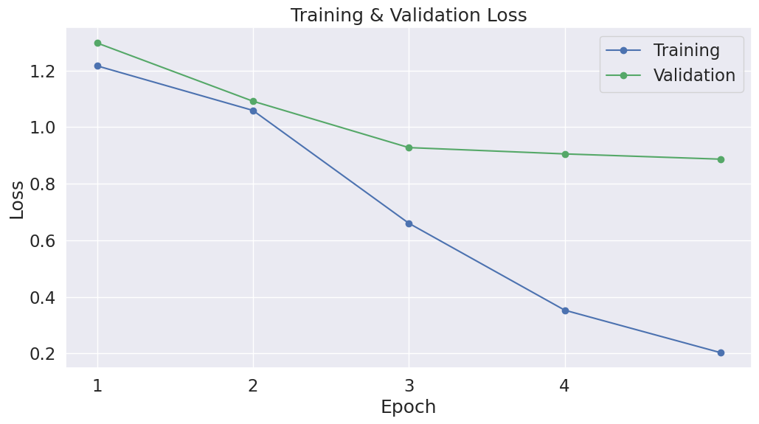
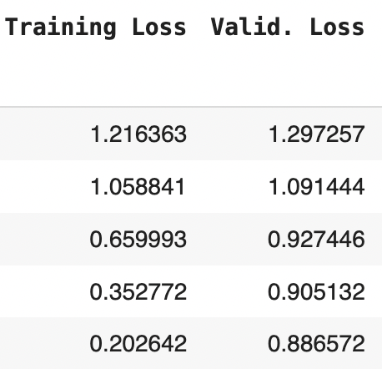
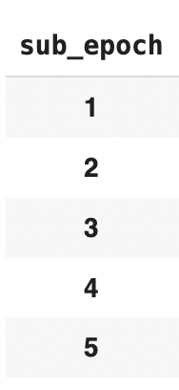
GPT2 Model

Slide 21
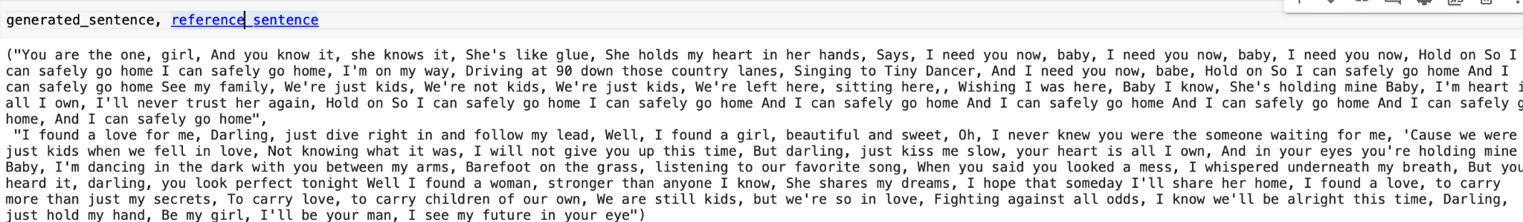
GPT2 Model
Perplexity -
Validation Perplexity: 2.426796710223497 and Train Perplexity: 1.1086199390533467
Lower perplexity generally means better performance, indicating that the model predicts the data more accurately. A significant difference between training and validation perplexity might indicate overfitting or issues with the model’s generalization capability.
Cosine Similarity - Cosine Similarity: 0.7358
The cosine similarity score of 0.7358 indicates a notable degree of semantic similarity between the two sentences.
ROUGE Score - ROUGE Scores: {'rouge1': 0.0311284046692607, 'rouge2': 0.0, 'rougeL': 0.0311284046692607}
The low ROUGE scores suggest that the generated text is quite different from the reference text in terms of both word and phrase overlap, as well as the sequence of words. But since both are different lyrics and we got cosine similarity good means they are similar to each other but since rouge score is less suggesting they are different song lyrics.

Slide 22
Limitations
NGram language models
Insufficient context, scant data, inability to process new information, absence of semantics, and set length.
RNN Long Short-Term Memory
Attempt to produce writing that has a logical overall structure.
Could produce text that is repeated.
May produce writing with a small vocabulary
Model GPT-2 transformer
Dimensions and processing needs
Possibility of creating language that is biased
Difficulty coming up with lengthy, cohesive language portions.

Slide 23
THANK YOU

